Slide 1



Enterprise Programming
Lecturer Parmanand Tiwari, Lecturer
Computer Science & Engineering

Slide 2
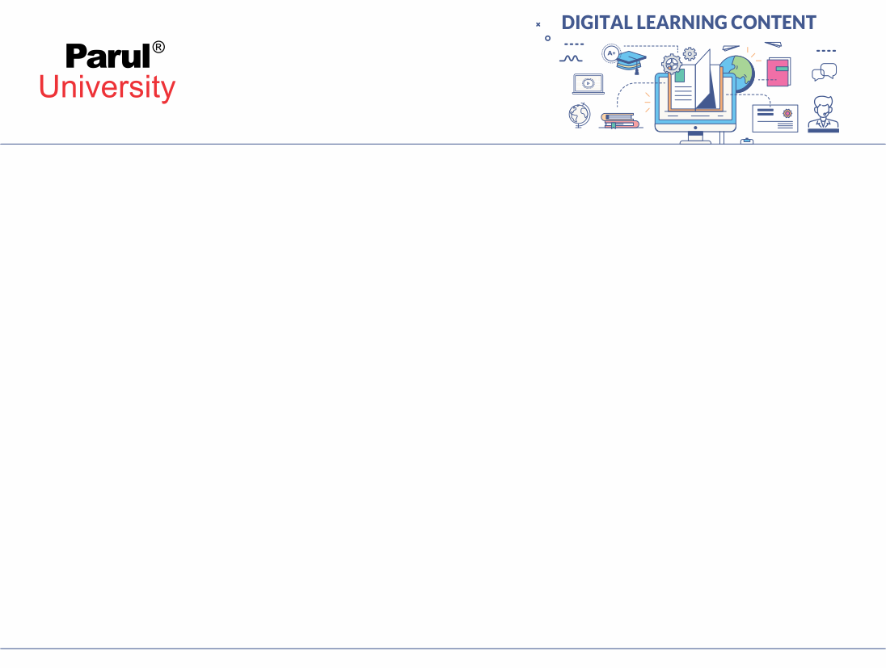

CHAPTER-4
Hibernate

Slide 3
What is Hibernate?
Hibernate is a Java framework that simplifies the development of Java application to interact with the database.
It is an open source, lightweight, ORM (Object Relational Mapping) tool. Hibernate implements the specifications of JPA (Java Persistence API) for data persistence. Developed in 2001 by Gavin King.

Slide 4
Introduction to Hibernate.
It is open source Object-Relational Mapping (ORM) tool for java.
Hibernate is responsible for making data persistent by storing it in a database.
Hibernate is light weight.
It was developed by Gavin King in 2001.

Slide 5
ORM TOOL
ORM simplifies database interaction in object-oriented programming languages by allowing developers to work with objects in their code while transparently handling the conversion to and form relational database tables. This leads to faster development cycles, reduced boilerplate code and improve maintainability of the codebase.
ORM stands for Object-Relational Mapping. It’s a programming technique use to convert data between incompatible systems by creating, in effect, a “virtual object database” that can be used from within the programming language.

Slide 6
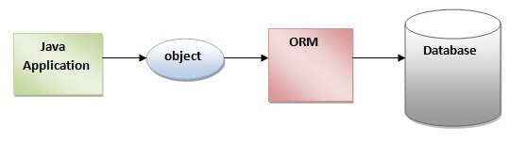

Slide 7
Hibernate Architecture
The architecture of Hibernate typically follows a layered design, with each layer responsible for specific aspect of database interaction and object-relational mapping.
Hibernate architecture includes many object such as persistent object, factory, transaction factory, connection factory, session, transaction etc.

Slide 8
Hibernate Architecture
The Hibernate architecture is categorized in four layer.
Java application layer
Hibernate framework layer
Backhand api layer
Database layer

Slide 9
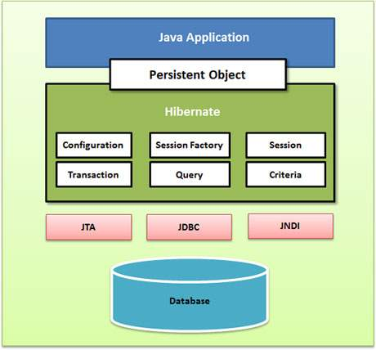
Hibernate Architecture
https://images.app.goo.gl/9QruozHi8uiEwbaJA

Slide 10
Hibernate Elements Architecture
Hibernate Core:- This is the main components of Hibernate, providing the basic functionality for mapping java object to database tables. It includes the SessionFactory, session and Transaction interfaces.

Slide 11
Hibernate Elements Architecture
Configuration Object:- The configuration object is the first Hibernate object you create in any Hibernate application. It is usually created only once during application initialization. It represents a configuration or properties file require by Hibernate.
The configuration object provides two keys components-
- database connection
- class Mapping setup

Slide 12
Hibernate Elements Architecture
Session Factory:- Configuration object is used to create a SessionFactory object which in turn configures Hibernate for the application using the supplied configuration file and allows for a Session object to be instantiated. The SessionFactory is a thread safe object and used by all the threads of an application.
The SessionFactory is a heavyweight object; it is usually created during application start up and kept for later use. You would need one SessionFactory object per database using a separate configuration file. So, if you are using multiple databases, then you would have to create multiple SessionFactory objects.

Slide 13
Hibernate Elements Architecture
Session Object:- A Session is used to get a physical connection with a database. The Session object is lightweight and designed to be instantiated each time an interaction is needed with the database. Persistent objects are saved and retrieved through a Session object.
The session objects should not be kept open for a long time because they are not usually thread safe and they should be created and destroyed them as needed.

Slide 14
Hibernate Elements Architecture
Transaction Object:- A Transaction represents a unit of work with the database and most of the RDBMS supports transaction functionality. Transactions in Hibernate are handled by an underlying transaction manager and transaction (from JDBC or JTA).
This is an optional object and Hibernate applications may choose not to use this interface, instead managing transactions in their own application code.

Slide 15
Hibernate Elements Architecture
Query Object:- Query objects use SQL or Hibernate Query Language (HQL) string to retrieve data from the database and create objects. A Query instance is used to bind query parameters, limit the number of results returned by the query, and finally to execute the query.

Slide 16
Hibernate Elements Architecture
Criteria Object:- Criteria objects are used to create and execute object oriented criteria queries to retrieve objects.
Cache:- Hibernate provides support for various levels of caching to improve performance. This includes first-level cache and second-level cache.

Slide 17
JPA
Java Persistence API (JPA) is a Java specification that provides a standardized way to persist Java objects into relational databases and manage their relationships. It offers a set of interfaces, classes, and annotations that enable developers to map Java classes to database tables, define object-relational mappings, and perform database operations using object-oriented approaches. JPA abstracts away the complexities of database interaction, allowing developers to focus on business logic rather than low-level JDBC code. It is a key component of Java EE (Enterprise Edition) and Jakarta EE platforms, widely used in Java enterprise applications for efficient and portable data persistence solutions

Slide 18
Key Components of JPA
1.Entity: An annotated Java class representing a table in the database.
2.EntityManager:The interface used to interact with the persistence context, Which manages the lifecycle of entities.
3. Persistence Unit: A set of entity classes that are managed together.
4.JPQL (Java Persistence Query Language): A query language similar to SQL but operates on java objects rather than database tables.
5.Transactions: A set of operations performed on the database as a single unit of word ensuring data integrity.
6.Annotation: JPA uses annotation like `@Entity`,`@Id`, etc to map java classes to database tables and define their properties.

Slide 19
Generator Class
In Hibernate a generator class is a strategy used to generate unique identifiers for entities. Entities are objects that are persisted to a database using Hibernate. Each entity typically has a unique identifier to distinguish it from other entities of the same type.
All Hibernate generator classes implements hibernate.id.IdentifierGenerator interface, and overrides the generate(SessionImplementor, Object) method to generate the identifier or primary key value. We can create our own generate the identifier or primary key value. We can create our own generator classes by implementing the identifierGeneratoe interface and by overriding the generatoe() method.

Slide 20
Generator Class
Hibernate provides various generator classes, each with its own strategy for generating identifiers.
Assigned
Identity
Sequence
Table
UUID
Foreign
Increment
Sequence
etc……

Slide 21
Assigned Generator Class
Assigned:- The `assigned` generator call in Hibernate allows the application to assign identifiers to entities before saving them to the database. This means that the entity objects must have their identifiers values set before persisting them using Hibernate. It is the default generator strategy if there is no <generator> element. In this case, application assigns the id.

Slide 22
Assigned Generator Class
Here’s how you might use the `assigned` generator class in Hibernate mapping file (XML).
<class name="Employee" table="employees">
<id name="id">
<generator class="assigned"/>
</id>
<property name="name"/>
<!-- other properties -->
</class>

Slide 23
Identity Generator Class
The `identity` generator class in hibernate delegates the responsibility of generating unique to the underlying database system. This strategy typically involves the use of auto-increment columns in relational databases. Identity generator supports databases like Sybase, MySql. MS SQL Server, DB2, and HypersonicSQL but doesn’t support Oracle database. Hence identity generator can be considered as a database-dependent generator.

Slide 24
Identity Generator Class
Here’s how you might use the `identity` generator class in Hibernate mapping file (XML).
<class name="Employee" table="employees">
<id name="id">
<generator class="identity"/>
</id>
<property name="name"/>
<!-- other properties -->
</class>

Slide 25
Sequence Generator Class
The `sequence` generator class in Hibernate is used to generate unique identifiers for entities by leveraging database sequence. Sequences are database objects designed to generate a sequence of unique numeric values, typically for use as primary key values in database table.

Slide 26
Sequence Generator Class
Here’s how you might use the `sequence` generator class in Hibernate mapping file (XML).
<class name="Employee" table="employees">
<id name="id">
<generator class="sequence">
<param name="sequence_name">employee_sequence</param>
</generator>
</id>
<property name="name"/>
<!-- other properties -->
</class>

Slide 27
Dialects
Dialect is a class that acts as a bridge between Java JDBC types and SQL types, which contains the mapping between java language data type and database datatype. Dialect allows Hibernate to generate SQL optimized for a particular relational database. Hibernate generates queries for the specific database based on the Dialect class. A hibernate dialect gives information to the framework of how to convert hibernate queries(HQL) into native SQL queries.

Slide 28
Dialects uses:
To generate Optimized SQL queries.
To interact with a particular Database if the application works with the help of more than one Database.
To set default values for hibernate configuration file properties based on the database software even though they are not specified in the configuration file.

Slide 29
List of Dialects in Hibernate
Oracle9i | org.hibernate.dialect.Oracle9iDialect
Oracle10g | org.hibernate.dialect.Oracle10gDialect
MySQL | org.hibernate.dialect.MySQLDialect
MySQL with InnoDB | org.hibernate.dialect.MySQLInnoDBDialect
MySQL with MyISAM | org.hibernate.dialect.MySQLMyISAMDialect
DB2 | org.hibernate.dialect.DB2Dialect
DB2 AS/400 | org.hibernate.dialect.DB2400Dialect
DB2 OS390 | org.hibernate.dialect.DB2390Dialect
Microsoft SQL Server | org.hibernate.dialect.SQLServerDialect
Sybase | org.hibernate.dialect.SybaseDialect
Sybase Anywhere | org.hibernate.dialect.SybaseAnywhereDialect
PostgreSQL | org.hibernate.dialect.PostgreSQLDialect
SAP DB | org.hibernate.dialect.SAPDBDialect
Informix | org.hibernate.dialect.InformixDialect
HypersonicSQL | org.hibernate.dialect.HSQLDialect
Ingres | org.hibernate.dialect.IngresDialect
Progress | org.hibernate.dialect.ProgressDialect
Mckoi SQL | org.hibernate.dialect.MckoiDialect
Interbase | org.hibernate.dialect.InterbaseDialect
Pointbase | org.hibernate.dialect.PointbaseDialect
FrontBase | org.hibernate.dialect.FrontbaseDialect
Firebird | org.hibernate.dialect.FirebirdDialect

Slide 30
SQL Dialects Configuration
The SQL dialect converts the HQL query which we write in java or any other object-oriented program to the specific database SQL query. For connecting any hibernate application with the database, it is required to provide the configuration of SQL dialect. We can provide it in hibernate.cfg.xml (DB2 Dialect) as :
<hibernate-configuration>
<session-factory name=”session-factory”>
<property name=“hibernate.dialect”>org.hibernate.dialect.DB2Dialect</property> </session-factory>
</hibernate-configuration>

Slide 31
Mapping
Hibernate mapping refers to the process of defining the relationship between Java objects and database tables in a Hibernate-based application. Hibernate is an object-relational mapping (ORM) framework that simplifies the interaction between Java applications and relational databases.
There are two main types of mapping in Hibernate:
Class Mapping
Association Mapping

Slide 32
Class Mapping
This involves mapping a Java class to a database table. Each persistent class in Hibernate should have a corresponding mapping file or annotations that define how its properties are mapped to columns in the database table.
You should save the mapping document in a file with the format <classname>.hbm.xml.
We saved our mapping document in the file Employee.hbm.xml.

Slide 33
Mapping Elements
1.The mapping document is an XML document having <hibernate-mapping> as the root element, which contains all the <class> elements.
2.The <class> elements are used to define specific mappings from a Java classes to the database tables.
3.The <meta> element is optional element and can be used to create the class description.
4.The <id> element maps the unique ID attribute in class to the primary key of the database table.
5.The <generator> element within the id element is used to generate the primary key values automatically. The class attribute of the generator element is set to native.

Slide 34
Mapping Elements
6. The <property> element is used to map a Java class property to a column in the database table. The name attribute of the element refers to the property in the class and the column attribute refers to the column in the database table. The type attribute holds the hibernate mapping type, this mapping types will convert from Java to SQL data type.

Slide 35
Association Mapping
This involves defining relationships between different persistent classes. Hibernate supports various types of associations such as one-to-one, one-to-many, many-to-one, and many-to-many relationships. These associations are specified using mapping files or annotations.

Slide 36
One-to-One Mapping
First of all we would need to setup One to One mapping in database tables.
We will create two tables for our example – Transaction and Customer.
Both of these tables will have one to one mapping.
Transaction will be the primary table and we will be using Foreign Key in Customer table for one-to-one mapping.
Transaction
Customer

Slide 37
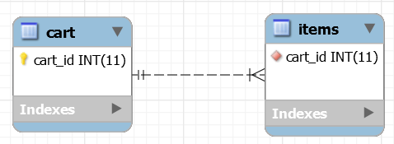
One-to-Many Mapping
A one-to-one association is similar to many-to-one association with a difference that the column will be set as unique. For example, an address object can be associated with a single employee object.

Slide 38
One-to-Many Mapping
For this example, we will implement a Cart system, where we have a table for Cart and another table for Items.
A Cart can have multiple items, so here we have a one-to-many mapping with cart_id as a primary key in the Cart table and this association is constrained by the foreign key in the Items table.

Slide 39
Many-to-one Mapping
A many-to-one association is the most common kind of association where an Object can be associated with multiple objects. For example, the same address object can be associated with multiple employee objects.
The <many-to-one>element is used to set the relationship between EMPLOYEE and ADDRESS entities.
The name attribute is set to the defined variable in the parent class, in our case it is address.
The column attribute is used to set the column name in the parent table EMPLOYEE.

Slide 40
Many-to-Many Mapping
Many-to-Many mapping is usually implemented in database using a Join Table.
For example we can have Cart and Item table and Cart_Items table for many-to-many mapping.
Every cart can have multiple items
and every item can be part of multiple carts, so we have a many to many mapping here.

Slide 41
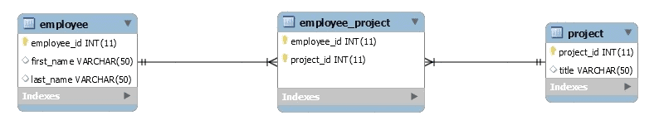
Many-to-Many Mapping
In this scenario, any given employee can be assigned to multiple projects and a project may have multiple employees working for it, leading to a many-to-many association between the two.
We have an employee table with employee_id as its primary key and a project table with project_id as its primary key. A join table employee_project is required here to connect both sides.

Slide 42
Hibernate Annotations
Hibernate Annotations is the powerful way to provide the metadata for the Object and Relational Table mapping. All the metadata is clubbed into the POJO java file along with the code, this helps the user to understand the table structure and POJO simultaneously during the development.

Slide 43
Environment setup for Hibernate Annotations
First of all you would have to make sure that you are using JDK 5.0 otherwise you need to upgrade your JDK to JDK 5.0 to take advantage of the native support for annotations.
Second, you will need to install the Hibernate 3.x annotations distribution package, available from the sourceforge: (Download Hibernate Annotation) and copy hibernate-annotations.jar, lib/hibernate-comons-annotations.jar and lib/ejb3-persistence.jar from the Hibernate Annotations distribution to your CLASSPATH.

Slide 44
@Entity Annotation
The EJB 3 standard annotations are contained in the javax.persistence package, so we import this package as the first step. Second, we used the @Entity annotation to the Employee class, which marks this class as an entity bean, so it must have a no-argument constructor that is visible with at least protected scope.

Slide 45
@Table Annotation
The @Table annotation allows you to specify the details of the table that will be used to persist the entity in the database.
The @Table annotation provides four attributes, allowing you to override the name of the table, its catalogue, and its schema, and enforce unique constraints on columns in the table. For now, we are using just table name, which is EMPLOYEE.

Slide 46
@Id and @GeneratedValue Annotation
Each entity bean will have a primary key, which you annotate on the class with the @Id annotation. The primary key can be a single field or a combination of multiple fields depending on your table structure.
By default, the @Id annotation will automatically determine the most appropriate primary key generation strategy to be used but you can override this by applying the @GeneratedValue annotation, which takes two parameters strategy and generator that I'm not going to discuss here, so let us use only the default key generation strategy. Letting Hibernate determine which generator type to use makes your code portable between different databases.

Slide 47
@Column Annotation
The @Column annotation is used to specify the details of the column to which a field or property will be mapped. You can use column annotation with the following most commonly used attributes −
name attribute permits the name of the column to be explicitly specified.
length attribute permits the size of the column used to map a value particularly for a String value.
nullable attribute permits the column to be marked NOT NULL when the schema is generated.
unique attribute permits the column to be marked as containing only unique values.

Slide 48
Hibernate Query Language(HQL)
Hibernate Query Language (HQL) is same as SQL (Structured Query Language) but it doesn't depends on the table of the database.
Instead of table name, we use class name in HQL. So it is database independent query language.
Keywords like SELECT, FROM, and WHERE, etc., are not case sensitive, but properties like table and column names are case sensitive in HQL.

Slide 49
Advantage of HQL
There are many advantages of HQL. They are as follows:
database independent
supports polymorphic queries
easy to learn for Java Programmer

Slide 50
Hibernate Query Language(HQL)
Example of HQL to get all the records
Query query=session.createQuery("from Emp"); //here persistent class name is Emp
List list=query.list();
Example of HQL to get records with pagination
Query query=session.createQuery("from Emp");
query.setFirstResult(5);
query.setMaxResult(10);
List list=query.list();
//will return the records from 5 to 10th number
Example of HQL delete query
Query query=session.createQuery("delete from Emp where id=100");
//specifying class name (Emp) not tablename
query.executeUpdate();

Slide 51
Hibernate Criteria Query Language(HCQL)
Hibernate Criteria Query Language (HCQL) is mainly used for further filetering records on the basis of logical conditions. HCQL works on the filtration rules and logical conditions. The Criteria interface, Restriction class, and Order class are available in org.hibernate package. These interfaces and classes provide the properties and methods to perform operations of HCQL.
In HCQL, we can only execute the select query. It doesn’t allow to use other queries like an update, insert, and delete.

Slide 52
Advantage of HCQL
Dynamic Queries- HCQL queries are good for executing dynamic queries, whereas HQL does not support dynamic queries.
Pagination – HCQL supports the concept of pagination. Pagination is a technique which divides result set in pages.
Database Independent- HCQL is also a database-independent query language. Queries written in HCQL can be run in any database.
Projection Class – The projection class is available in org.hibernate.criterion.Projection package which can be used to get minimum, maximum, sum, count, and average of the property values

Slide 53
Criteria Interface
The Criteria interface is part of org.hibernate package. It is used to retrieve entities by creating criterion objects. Based on given conditions, it is used to search objects or data.
There are many methods available in the Criteria interface to specify the criteria. Following are some methods of the Criteria interface:

Slide 54
Criteria Interface
Method | Description
public Criteria add(Criteria c) | It is used to add restrictions on the result.
public Criteria addOrder(Order o) | It is used to define the order of the result. Ascending or descending.
public Criteria setFirstResult(int firstResult) | It is used to set the first record in the result
public Criteria setMaxResult(int totalResult) | It is used to restrict maximum number of records
public List list() | Returns the list of fetched records
public Criteria setProjection(Projection projection) | Applies projection on the retrieved objects
public Criteria createAlias(String associationPath, String alias) | Used to create alias on joined association

Slide 55
Order Class
To sort the records of the query, we use Order class. Using this class, we can sort the records in ascending or descending order.
Following are the methods of Order class:
public static Order asc(String propertyName)
Example of Order.asc
Crietria criteria = session.createCriteria(Employee.class);
Criteria.addOrder(Order.asc(“name”));
List list=criteria.list();
public static Order desc(String propertyName)
Example of Order.desc
Crietria criteria = session.createCriteria(Employee.class);
Criteria.assOrder(Order.desc(“name”)); List list = criteria.list();

Slide 56
Restrictions Class
Restrictions class provides several methods which can be used to add restrictions to the criteria object. Following are the methods of org.hibernate.criterion.Restrictions package.
public static SimpleExpression eq(String propertyName, Object value)
Here ‘eq’ stands for equal. It is used to apply an ‘equal to’ constraint on the given property.
Example of Restrictions.eq
Criteria criteria = session.createCriteria(Employee.class);
Criteria.add(Restrictions.eq(“empId”,10));
List list = criteria.list();

Slide 57
Restrictions Class
public static SimpleExpression ge(String propertyName, Object value)
‘ge’ is abbreviation for greater than or equal to.
Example of Restrictions.ge
Criteria criteria = session.createCriteria(Employee.class);
criteria.add(Restrictions.ge(“empId”,10));
List list = criteria.list();
public static SimpleExpression gt(String propertyName, Object value)
‘gt’ stands for greater than.
Example of Restrictions.gt
Criteria criteria = session.createCriteria(Employee.class);
criteria.add(Restrictions.gt(“empId”,10));
List list = criteria.list();

Slide 58


www.paruluniversity.ac.in

